Slide 1
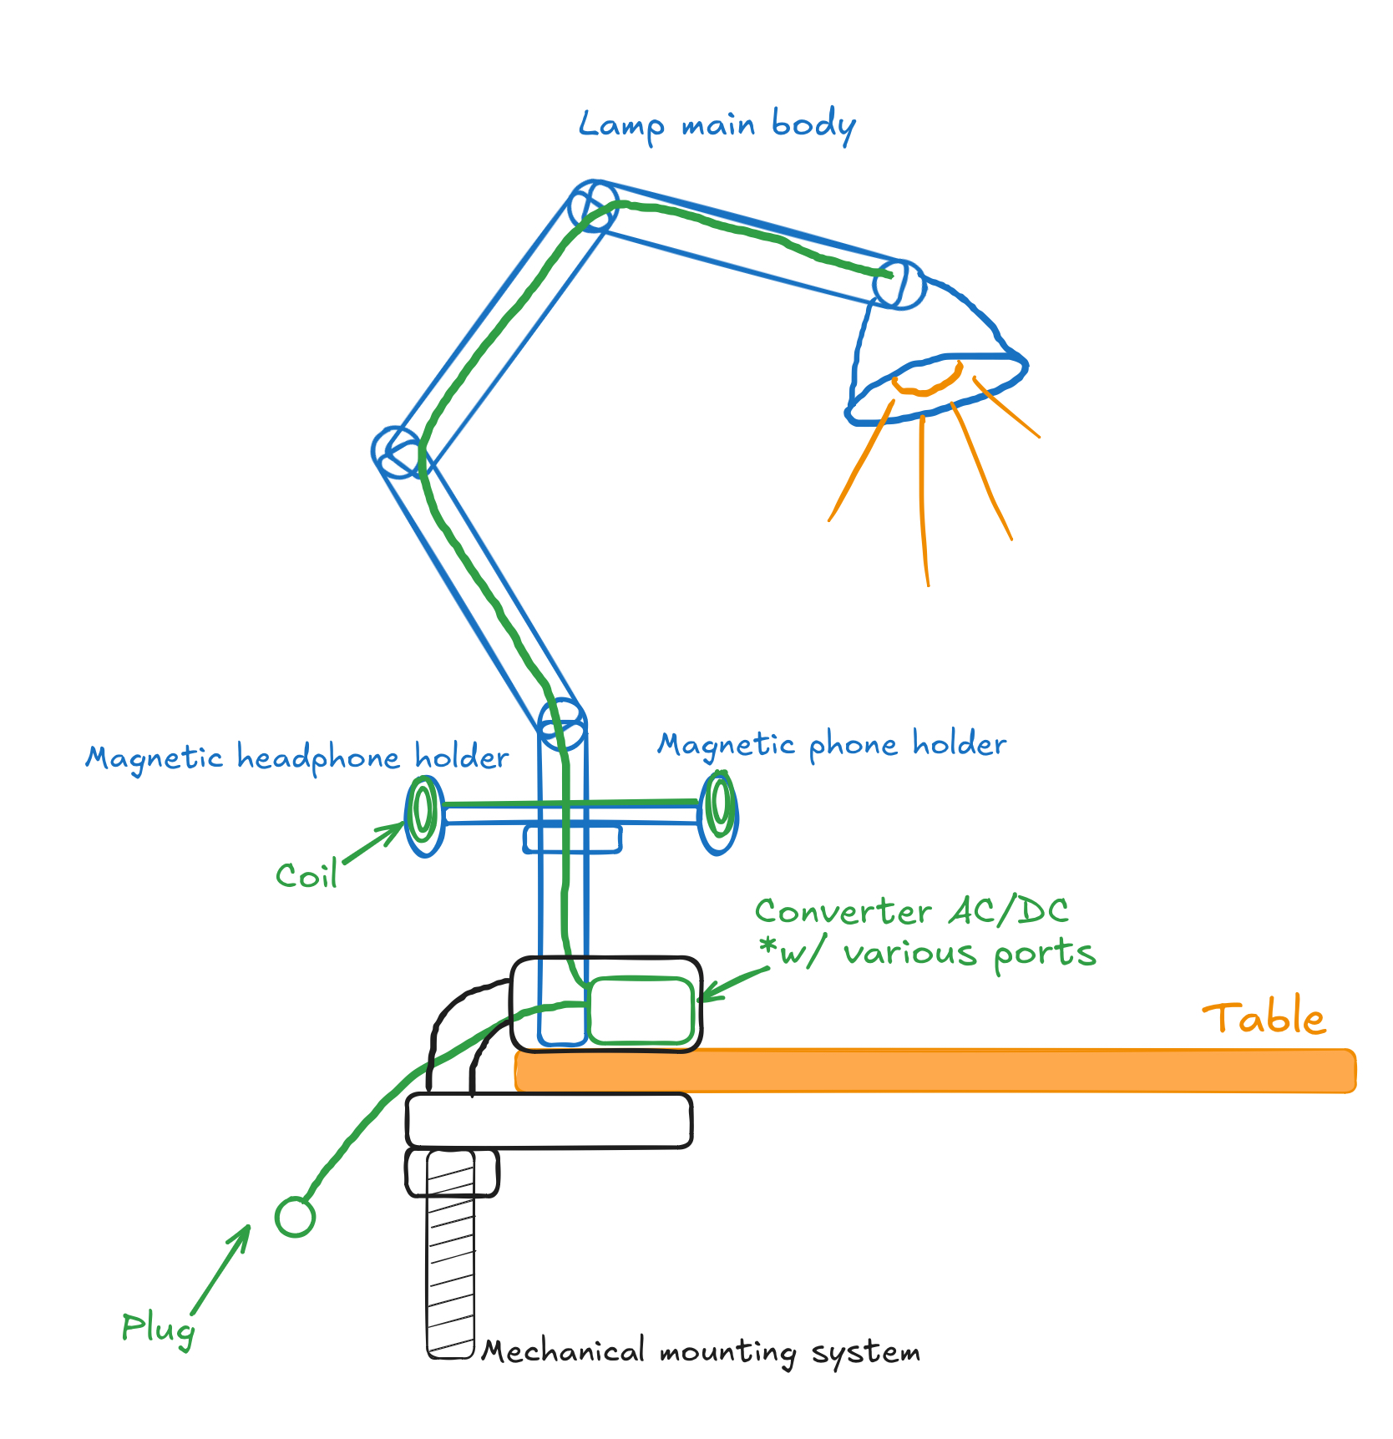

Multifunctional Lamp Design
Machine Design and Production Technology
Fall Semester 2024
Team Members:
Batsuuri Tumendelger
Cheap Lyly
Tóth Bence
Mufian Muhammad Haekal
Hafsa Al-Mamari

Slide 2
Agenda
Introduction
Product Design Process
Quality Tools
Concept Generation and Selection
SolidWorks Design

Slide 3
Introduction
Problem Description:
The project focuses on an innovative design that integrates multiple essential facilities to support students in managing their multitasking needs effectively. Throughout the design process, our team will navigate various stages of development, ensuring a comprehensive approach to addressing these requirements and delivering a functional, student-centered solution.
Aim:
To design and develop a user-friendly, multitasking product for students that enhances their overall experience and supports their diverse needs effectively

Slide 4
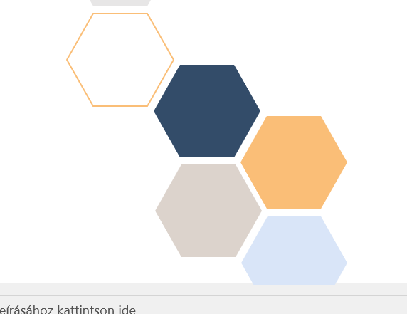
Product Design Process
Planning
Customer requirements
Quality tools strategies
Concept generation & Selection
Launch The design
We started with brainstorming session to select the idea. As a method we use Fluffy words list (to show how the product look like) We came up with creative solutions and made a decision on the key features that would best support students’ multitasking needs.
The customer requirements were gathered and analyzed using the Voice of Customer (VOC) approach, ensuring that the design aligns with their needs and expectations.
There are many tools have been used:
Morphology Matrix sheet
PUGH matrix sheet
RACI matrix sheet
Fast diagram
VOC
Failure Mode and effects analysis sheet
There are 3 main concepts that have been generated.
We developed the selected concept using SolidWorks, creating a detailed and accurate design to bring the idea to life.

Slide 5
3. Quality Tools
The Quality tools are essential for ensuring a structured and efficient design process. They help in analyzing customer needs, generating innovative concepts, evaluating alternatives, and identifying potential risks. We used the following quality tools:
RACI matrix sheet.
VoC ( Voice of Customer )
PUGH matrix sheet.
FAST diagram.
Morphology Matrix sheet.
Failure Mode and Effect Analysis sheet.
3

Slide 6
3.1 RACI (Responsible, Accountable, Consult, Inform) Matrix Sheet
The RACI matrix is a simple tool we used to assign roles and responsibilities within the team. It helped clarify who is Responsible, Accountable, Consulted, and Informed for each task, ensuring the project runs smoothly without confusion or overlap.
4

Slide 7
3.2 Voice of Customers
The Voice of Customer (VoC) is a process used to capture and understand the needs, preferences, and expectations of customers in order to create user-centered designs that meet real-world demands.
Through the extensive list of customer requirements, we assigned weights to each feature based on its importance to the users. After careful evaluation, the key priorities identified were:
Safety: Prioritizing user safety by minimizing risks in design and functionality.
Stability: Ensuring the product remains secure and functional during use.
Portability: Designing the product to be easily moved or adjusted as needed.
Durability: Creating a robust product that can withstand prolonged use.
Lightweight: Ensuring the product is easy to handle and transport while maintaining its functionality.
5

Slide 8
3.3 Fast Diagram
The FAST diagram helps us break down the main function of the design into smaller steps, showing how each part works and why it's needed. It's a simple way to understand the system better and find ways to improve or make it more innovative.
Main Function
Multifunctional work and study assistance
Sub Function 1
Lightening
Sub Function 2
Charging
Sub Function 3
Organizing
6

Slide 9
3.4 Pugh Matrix Sheet
Attributes
Safe
Stable/Attachable
Portable
Durable
Size
Lightweight
User-friendly
Fun
Multifunctional
Price
Repairable
Chargeable
The Pugh matrix sheet is a decision-making tool used to evaluate and compare multiple design options against specific criteria, helping to identify the most suitable solution systematically. The main four concepts were evaluated based on a scoring system derived from pairwise VOC analysis.
The sum of the weighted scoring based on these attributes then resulted in our winner concept. Which will be introduced later on.
7

Slide 10
3.5 Morphology Matrix Sheet
Key Functions
Control brightness
Collect energy
Give energy
Store energy
Hold items
Maintain stability
Enable portability
Change light colour
Retain appearance
The Morphology Matrix sheet is a tool used to break down the design into its key components, exploring and combining various options for each component to generate innovative and practical solutions. Several solutions were identified based on the functions derived from the FAST diagram,
8

Slide 11
3.6 Failure Mode and Effects Analysis Sheet
The Failure Mode and Effects Analysis (FMEA) sheet is used to identify potential failure points in the design, assess their impact, and prioritize actions to reduce risks and ensure product reliability and safety.
It is done by rating the potential failure mode on three different levels:
Severity
Occurrence
Detection
The product of these three factors gives the RPN number.
The highest RPN number FMEA in our case → battery lifespan reduction (due to its very high occurrence)
9

Slide 12
Concept Generation
Short description:
This concept is a multifunctional >>>>>designed to enhance user convenience and productivity. It features a flexible and adjustable lamp arm with a main light source to provide focused illumination. Additionally, it includes magnetic holders for headphones and a phone, offering an organized workspace. The base includes an AC/DC converter with various output ports, enabling users to charge multiple devices. The system is mounted securely to a table using a mechanical mounting system for stability. A coil system is integrated to improve functionality, potentially for power or structural support.
Pros:
Multifunctionality: Combines lighting, charging, and organization in a single product.
Stability: The mechanical mounting system ensures secure attachment to the table
User-friendly: Easily accessible features improve the overall experience.
Cons:
Cost: The inclusion of diverse functionalities may result in higher production costs.
Durability Concerns: The moving parts, such as the arm and magnetic holders, may wear out over time.
Concept A
Figure 1: Concept A.
10

Slide 13
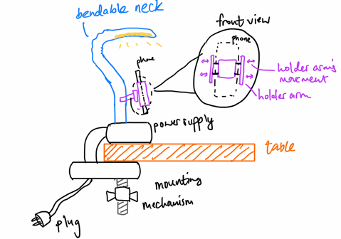
Concept Generation
Short description:
This concept is a conventional lamp with a quirky twist. It also features a flexible and adjustable lamp arm but instead of magnetic attachment, it consists of a holder arm that offers a playful environment. The base includes an AC/DC converter with various output ports, enabling users to charge multiple devices. The system is mounted securely to a table using a mechanical mounting system for stability.
Pros:
Multifunctionality: Combines lighting, charging, and organization in a single product.
Stability: The mechanical mounting system ensures secure attachment to the table
User-friendly: Easily accessible features improve the overall experience.
Cons:
Cost: The inclusion of a simpler object attachment mechanism may result in a lower production cost compared to concept A.
Durability Concerns: The moving parts, such as the arm and magnetic holders, may wear out over time.
Concept B
Figure 2: Concept B.
11

Slide 14
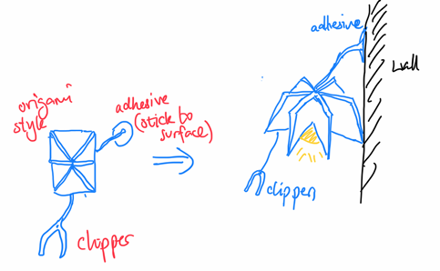
Concept Generation
Short description:
This concept is a lamp with an innovative concept featuring an origami structure to enhance portability. It is also multifunctional with charging options and clippers as an object holder. Furthermore, it also uses a touch sensor.
Pros:
Multifunctionality: Combines lighting, charging, and organization in a single product.
Stability: The direct attachment to surfaces may not be as stable as a mounting mechanism but is more flexible, applicable to multiple types of surfaces and not just tables.
User-friendly: Easily accessible features improve the overall experience.
Cons:
Cost: The inclusion of a simpler object attachment mechanism may result in a lower production cost compared to concept A.
Durability Concerns: The moving parts, such as the arm and magnetic holders, may wear out over time.
Concept C
Figure 3: Concept C.
12

Slide 15
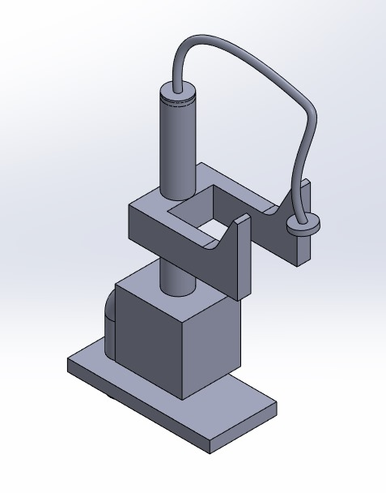
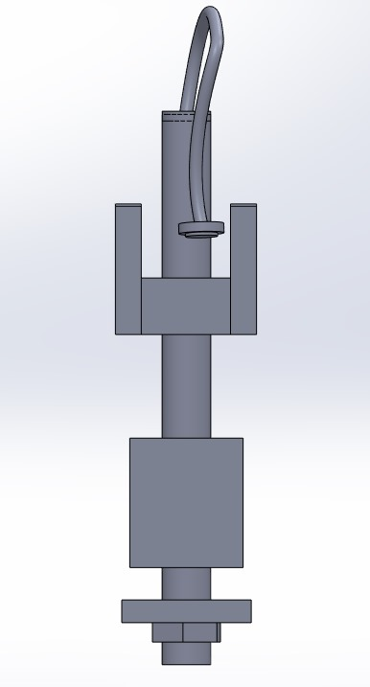
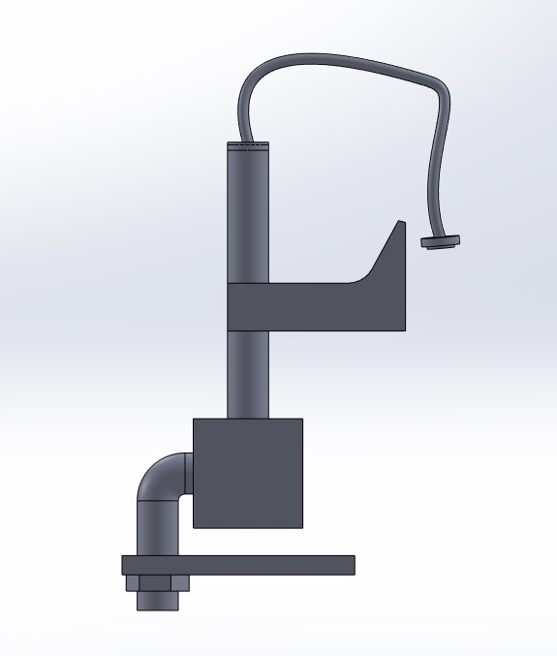
Solidworks Design
13

Slide 16

6. Future work
The team plans to:
Simulate the design with detailed calculations to verify its stability under various conditions and ensure it meets safety requirements
Build a physical prototype of the design to test how it works and ensure it meets our goals.
Perform tests to check the product's durability, stability, and overall performance.
Improve the design based on feedback from the tests to make it more efficient, cost-effective, and user-friendly.
Choose the best materials for manufacturing, balancing durability, weight, and cost.
14

Slide 17
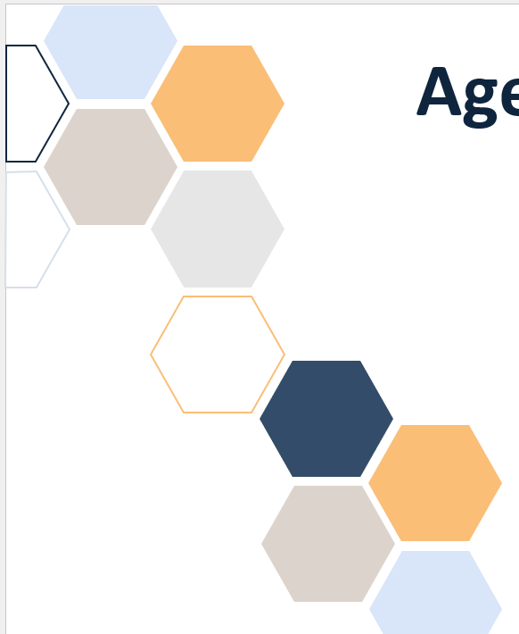
7. Summary
In this project, we utilized several quality tools:
Morphology Matrix
FAST diagram
PUGH Matrix
FMEA
VoC (Pairwise comparison)
RACI Matrix
These tools helped us to develop and evaluate four main design concepts. These concepts were assessed based on key criteria, and the best one was selected for further development. The chosen concept was modeled in SolidWorks, incorporating features such as stability, portability, durability, and user-friendliness.
15

Slide 18
Thank you for your attention!

